Slide 1
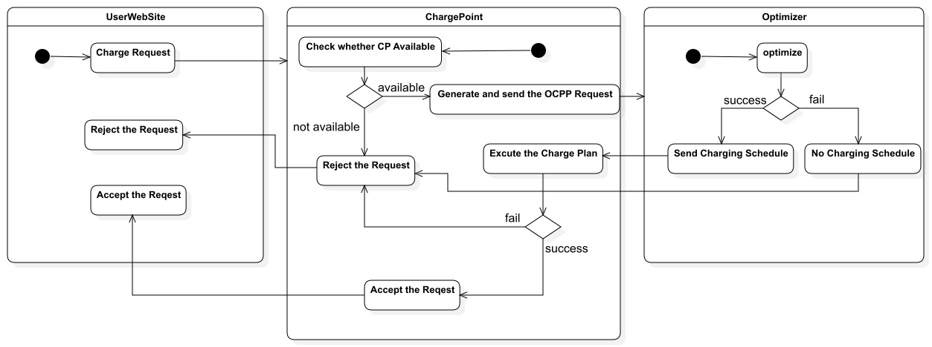
Complete Charging Process

Slide 2
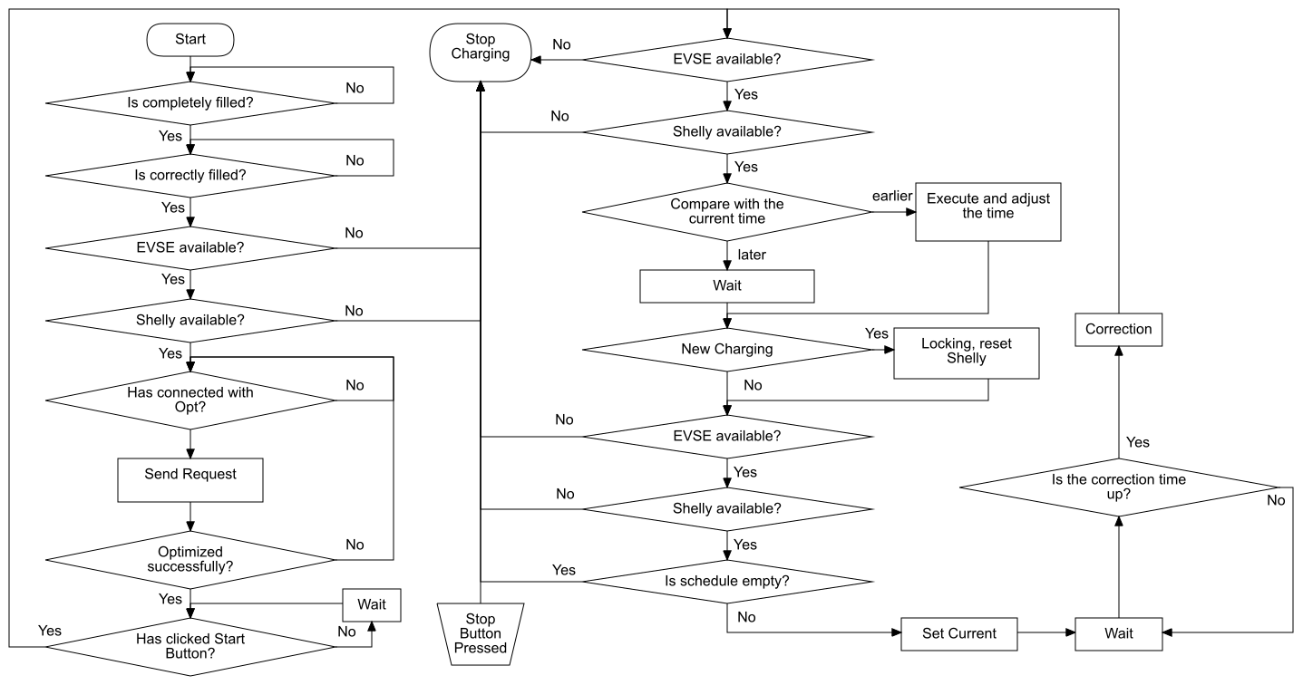
Complete Charging Process

Slide 3
Safety Measure
Electrical:
High-voltage circuit breaker
Fuse
Component Grounding
Software Logic:
Error-triggered emergency stop charging action
necessary condition checks before operation
Error Display on Web Page and Error Indication by LED
Network Security:
None.
Data Security:
None.

Slide 4
Signal——complex calls
Synchronous mode
Web Server
Central Processor
GPIO Management
Charge Unit
handle web message
WebSocket
handle websocket message
Data Management
handle ocpp message
Charge Unit
handle EVSE data
handle Shelly data
handle Shelly data
OCPP
Message
Message Recorder
handle charge unit
handle EVSE data
Polling Shelly
Polling EVSE
handle web message
handle websocket msg

Slide 5
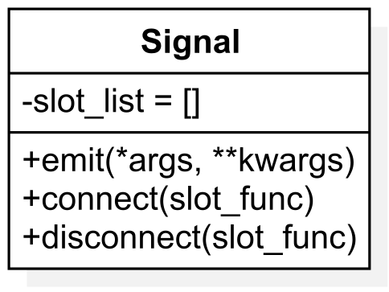
Signal——Implementation
add
remove
function
slot_list
None
connect
disconnect
Synchronous mode
emit
Visit the slot_list
Loop through list
execute functions
Finished

Slide 6
multitask——concurrency & Parallelism
Task1
Task2
Time
sequential execution
Task1
Task2
Time
concurrency
One task is executed in a time period
Task1
Task2
Time
parallelism
faster
Multiple tasks are executed in a time period

Slide 7
multitask——Coroutine
A coroutine is a lightweight, cooperative function that can pause and resume its execution without blocking the main thread, allowing efficient multitasking within a single thread.
Aspect | Coroutine | Multithreading
Execution | Controlled by developer | Controlled by OS
Threads count | 1 | multiple
Performance | Low overhead No thread creation No context switching | High overhead Many thread creations Frequent context switching
Memory usage | Shared memory, low usage | Higher usage

Slide 8
Multitask——Asynchronous isolation
await
synchronous
async IO operation func
Loop read and call
IO operation func
await
async func A
Put message in Queue
Message/Call
func A
Queue
async func B
await
func B
Loop
read and call
async func C
signal
await
func C
asynchronous
async func D
await
func D
async func E
await
func E

Slide 9
Limitation of the OCPP Library
No Concurrency
20
30
Time (s)
0
Allowed Message Handling Time
Actual Handling Time
Timeout Error

Slide 10
Modbus
Modbus is a simple communication protocol designed for connecting industrial devices and systems, allowing them to exchange data
Supports Serial (RTU, ASCII) and TCP/IP
Simplex
Only Response
Master
RX
TX
Slave
TX
RX
Only Request

Slide 11
WebSocket
WebSocket is a communication protocol designed for real-time, interactive web applications.
Full-Duplex
Persistent Connection
Aspect | Socket | WebSocket | HTTP
Protocol | TCP/UDP | TCP | TCP
Connection Type | Persistent | Persistent | Non-persistent
Communication | full-duplex | full-duplex | client requests, server responds
Data Format | Binary or text | Binary or text | Text
Overhead | Minimal | Low | High
Performance | High | High | Moderate

Slide 12
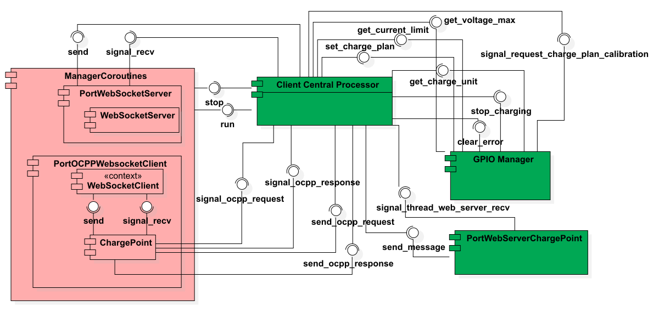
System Structure
Grün: Thread
Pink: Coroutine
Knoten: Methode/
Funktion/
Signal

Slide 13
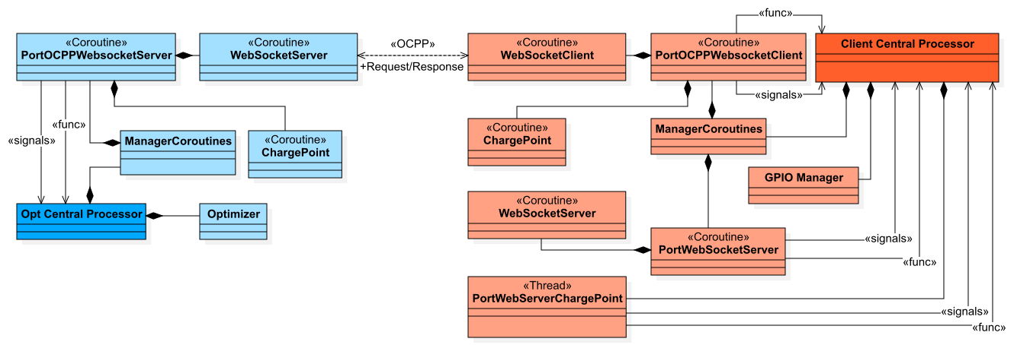
System Structure

Slide 14
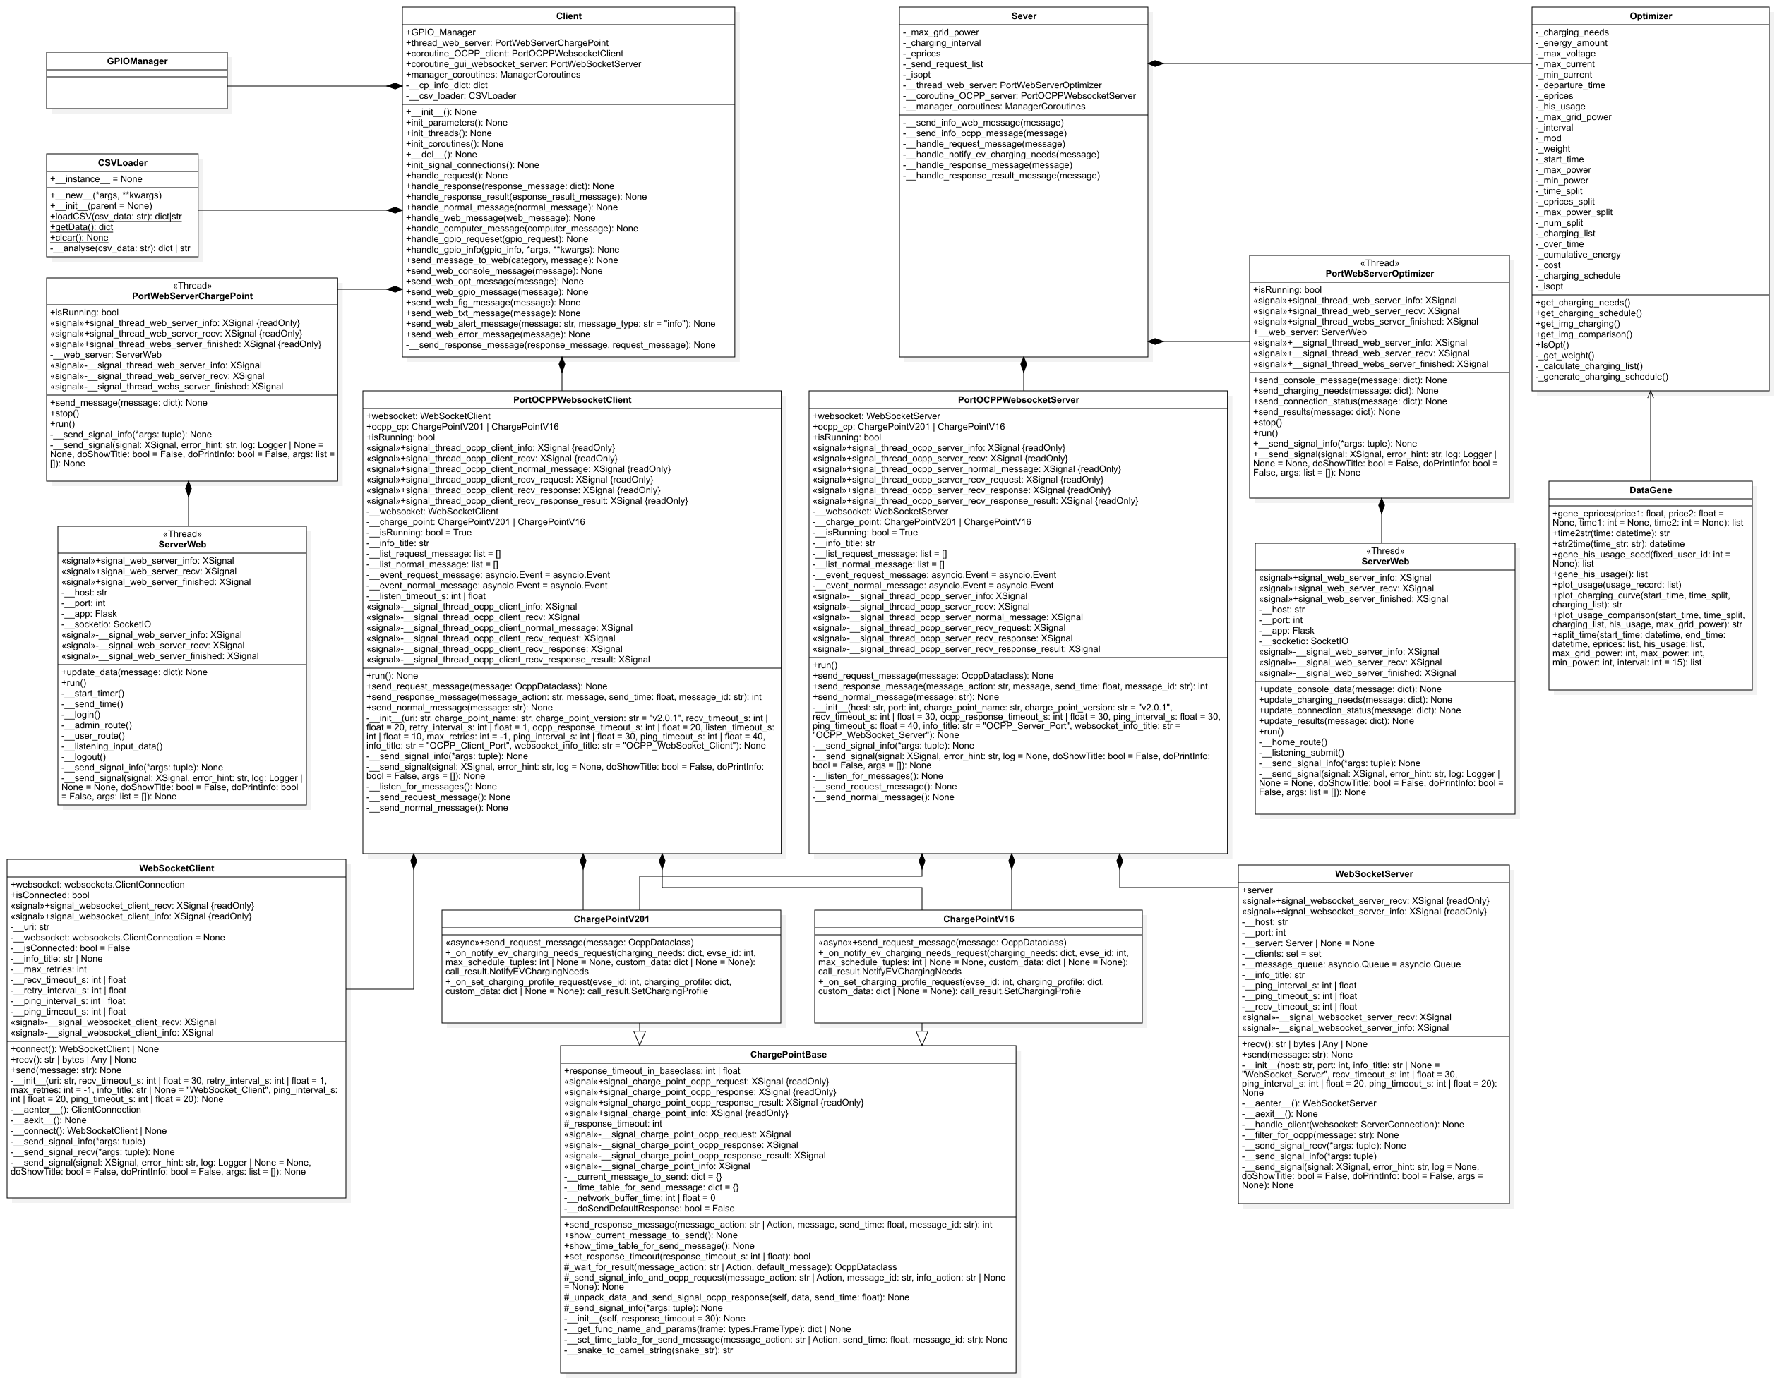
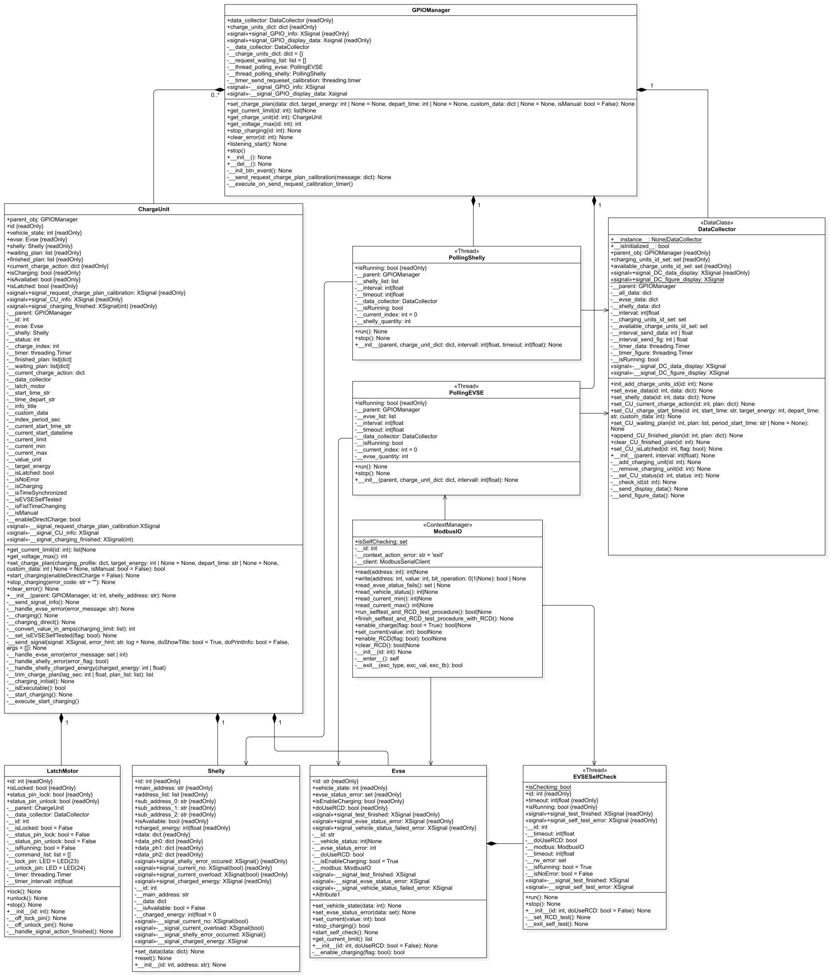
System Structure

